Slide 1
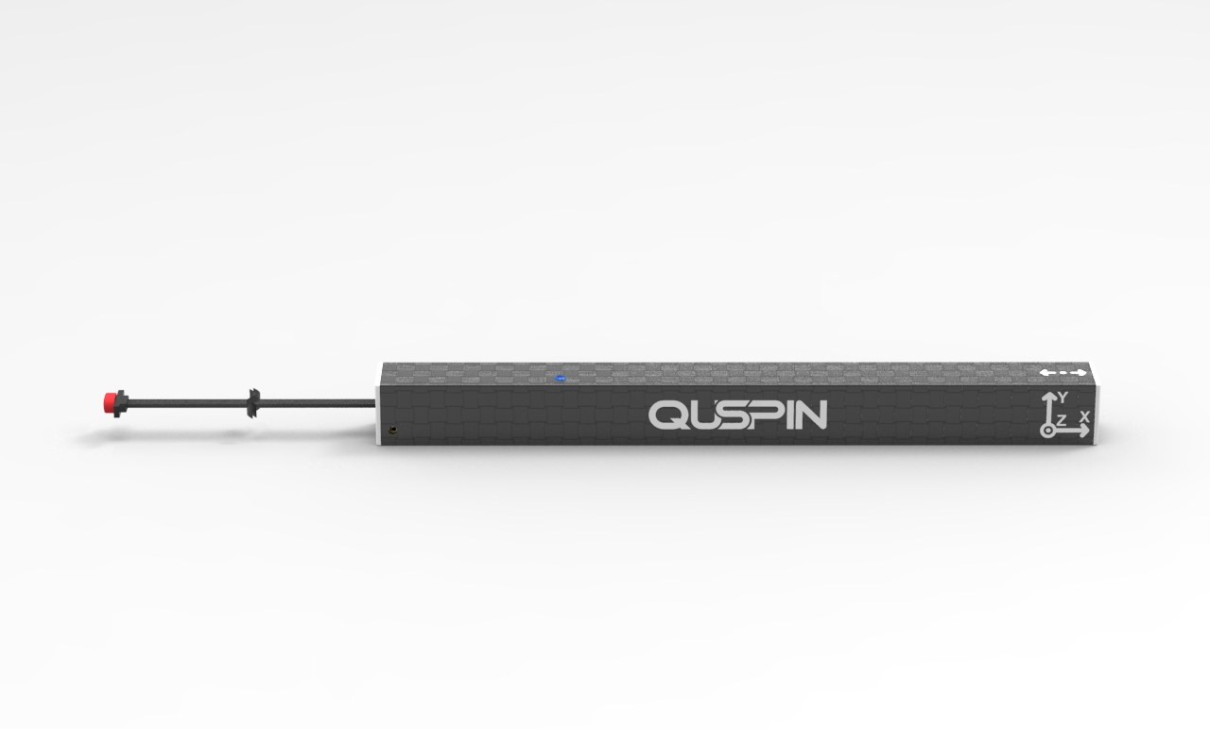
Cable Length:36”
12.16” (309mm)
1.1” (28mm)
1.1” (28mm)
Gen-2 QTFM carbon fiber case (QTFM-CF)
Weight: 150g (with sensor inside)
Fits sensors with or without vector add on
Is compatible with Gen-2 QTFM & Gen-2 QTFM-B
Not compatible with Gen-1 QTFM

Slide 2
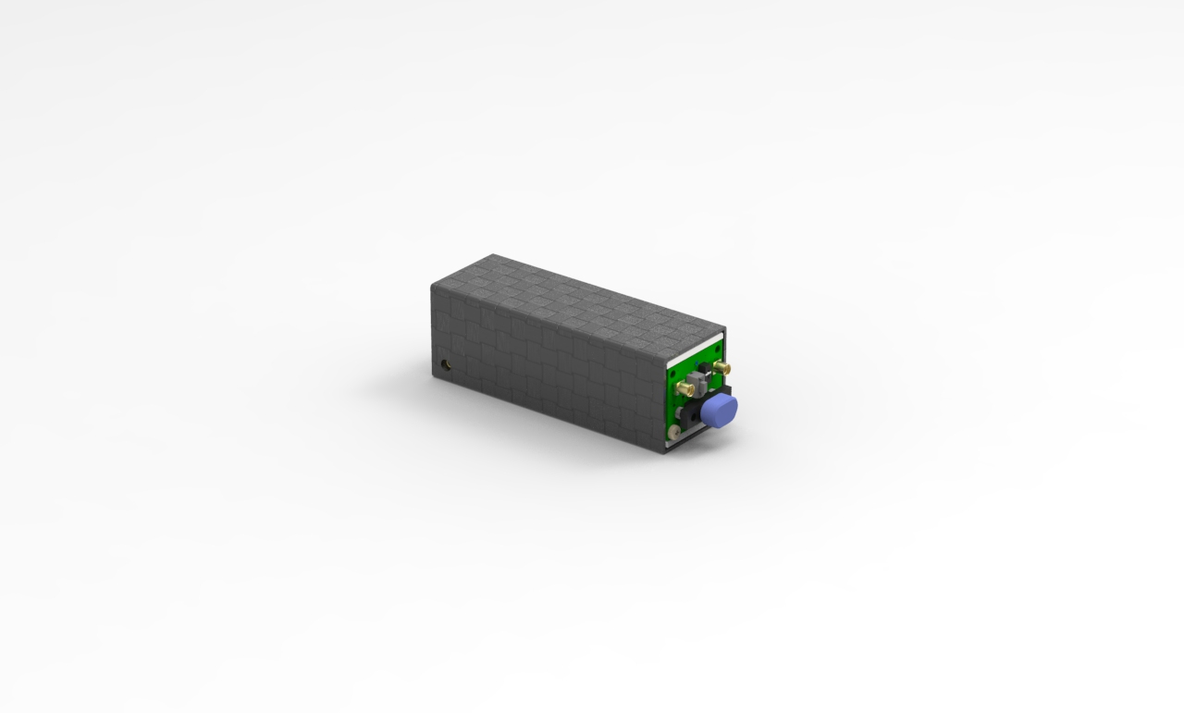
1.1” (28mm)
3.54” (90mm)
1.1” (28mm)
Standard Communications Board Carbon Fiber Case (SCB-CF)
Weight: 41g
Included with purchase of QTFM-CF

Slide 3
Extender Cable
36” Extender Cable for easy integration
Connector Type: 9-pin Micro-D plug(Male Pins) to wire leads
Connects directly to sensor Micro-D Socket (female pins), 72” total cable length
Part Number: M83513/08-A04
Included with purchase of QTFM-CF

Slide 4
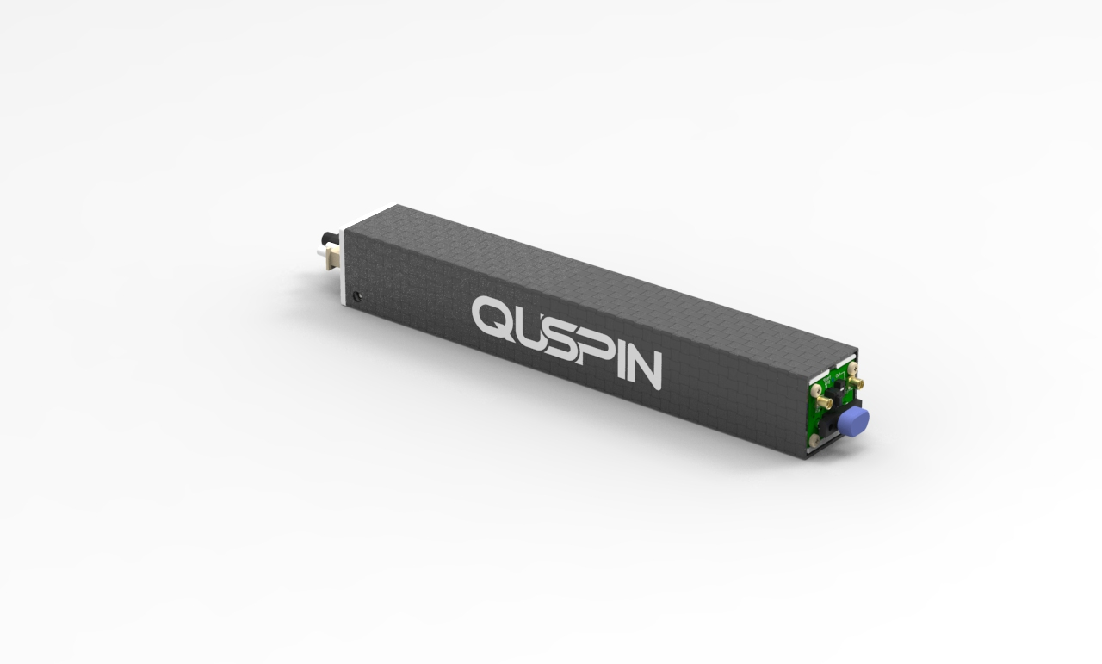
1.1” (28mm)
7.75” (197mm)
1.1” (28mm)
Gen-2 QTFM2 Advanced Communications Board Carbon fiber Case (ACB-CF)
Weight: 110g (with ACB, GPS, Bluetooth, inside)Fiber

